Slide 1
Managing Switches as a Stack Arista CloudVision Studios
Brian Hayes , Robert Cartelli

Slide 2
Interface Configuration Studio Enhancements
Studio has been enhanced to support Stacks and easy multi-interface configurations
New profile types have been added for POE, Dot1x, ACLs, QOS
Vlan interfaces and IP setting have been added

Slide 3
How do we manage many switches as one?
We treat them as a single unit in Studios
common Tag
Arista
Arista
Arista

Slide 4
Switches in a Stack share a common tag
Tags such as Leaf-Domain or Campus can be used
Any arbitrary group of switches can be tagged and Stacked
sw
sw
sw
sw
sw
sw
Common Tag

Slide 5
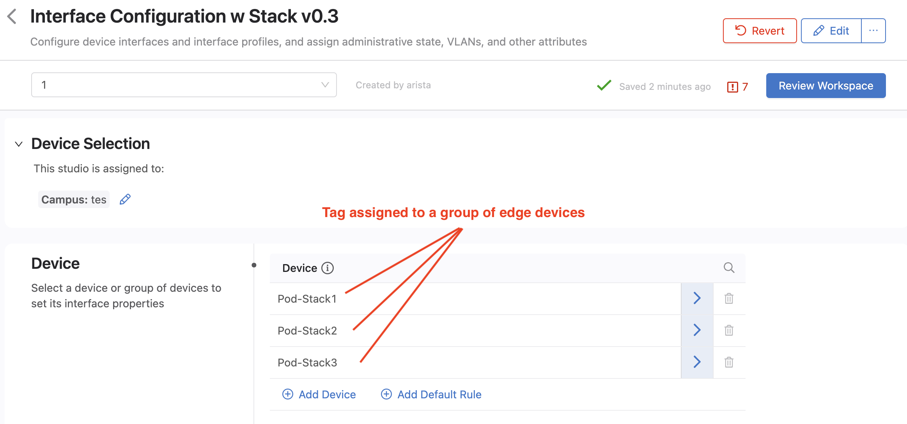
Stack Tags
Pod-Stack1
Add a “Stack” tag to any group of switches
Or use any existing tag
Pod-Stack2
Pod-Stack3

Slide 6
Distributed Switches
Remote Switches can be in a Stack
Stack Numbers exist only in the Mgt plane
This can create powerful solutions
#1
#2
#3
#4
Common Tag

Slide 7
Example: Slice the Stack into Functional Groups
Slice certain Port ranges across the Stack
1-20
21-39
40-48
Phones
APs
Cubes
Uplinks
Stack Member 1
Stack Member 2
Stack Member 3

Slide 8
EOS Version do not need to be the same
Unlike a data plane Stack we can mix OS versions
Phones
EOS 25.1
Stack Member 1
EOS 26.1
Stack Member 2
EOS 27.0
Stack Member 3

Slide 9
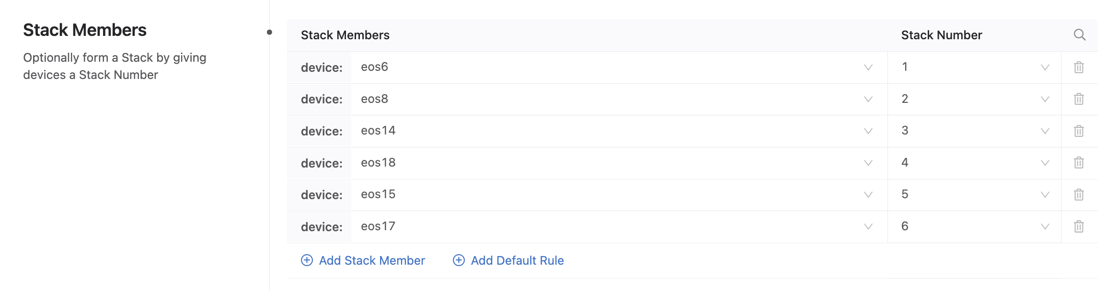
Assign Stack Member Number to devices
Pod-Stack3
1
2
3
Stack Number
4
5
6

Slide 10
Stacks can potentially be huge
Arista
Arista
Managing switches this way consumes no extra resources on the switch
Arista
Arista
Arista
Arista
Arista
Arista
Arista

Slide 11
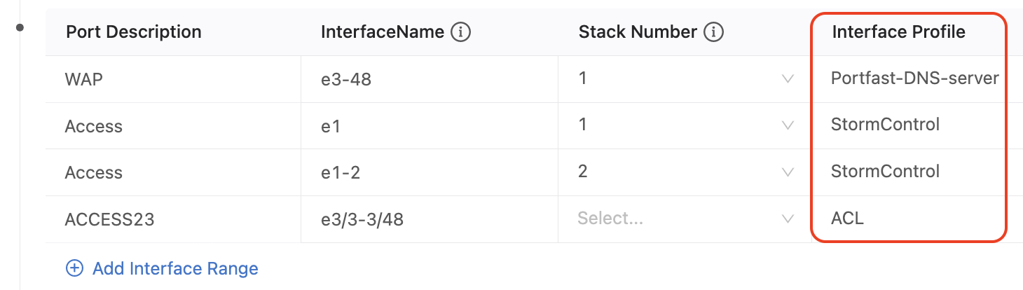
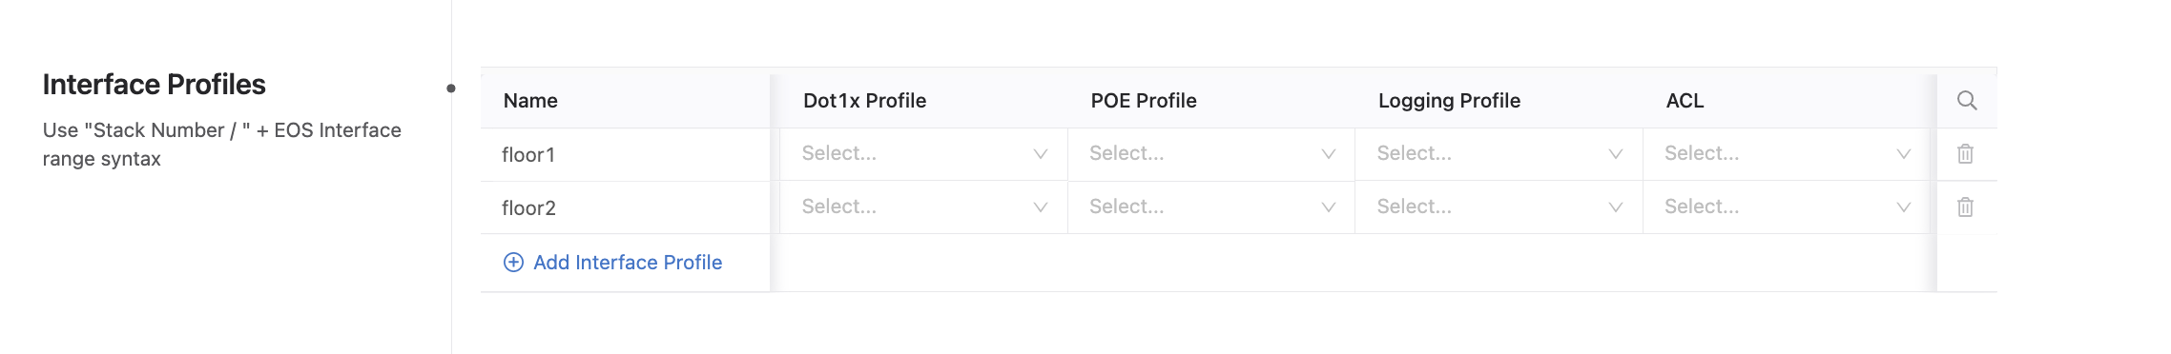
Interface Profiles
2. Apply Profiles to port ranges
Functional Profiles are grouped together to form “Interface Profiles” so a group of profiles to applied to the ports
FUNCTIONAL PROFILES
POE profile
DOT1Xprofile
ACLs, Logging Profile
QOS Profile
VLAN Profile (this is the old profiles section)
INTERFACE PROFILE
PORT
1. Set up your profiles

Slide 12
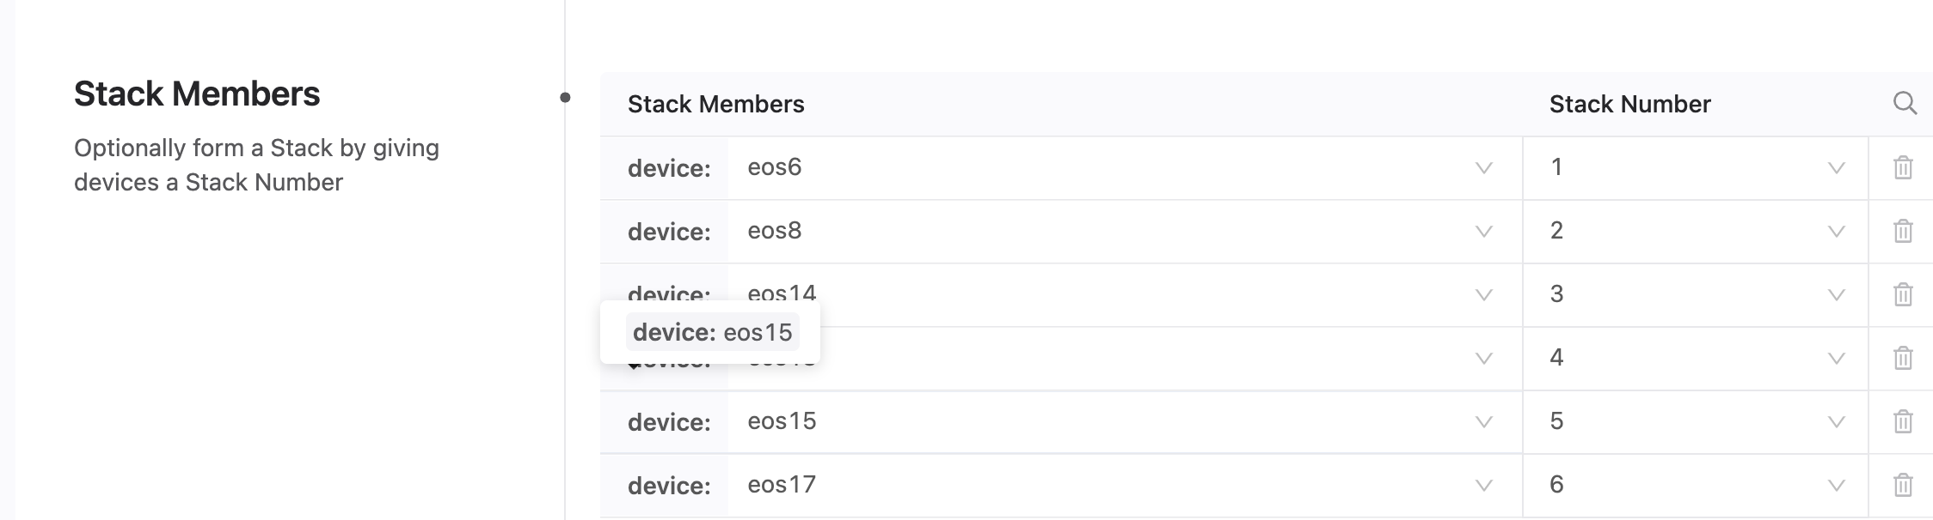
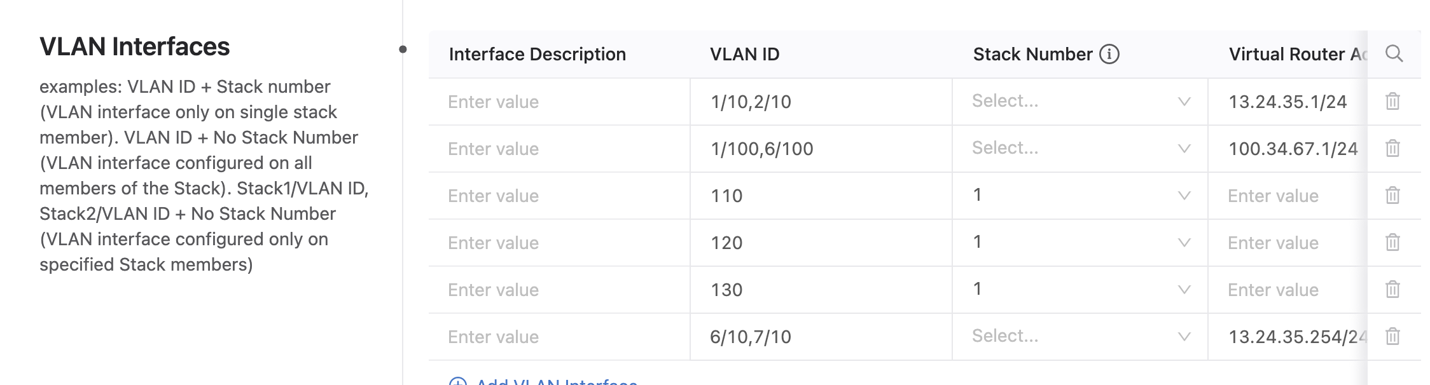
Vlan Interfaces
Vlan interfaces and IP settings are supported
Select Stack Number or use Stack notation

Slide 13
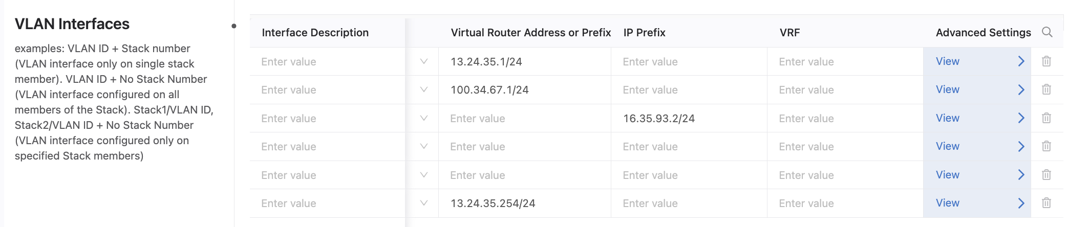
VLAN Interface IP Settings
IP settings for Vlan Interfaces – IP, vIP, Helpers, Secondary Addresses, VRF, Default gateway

Slide 14
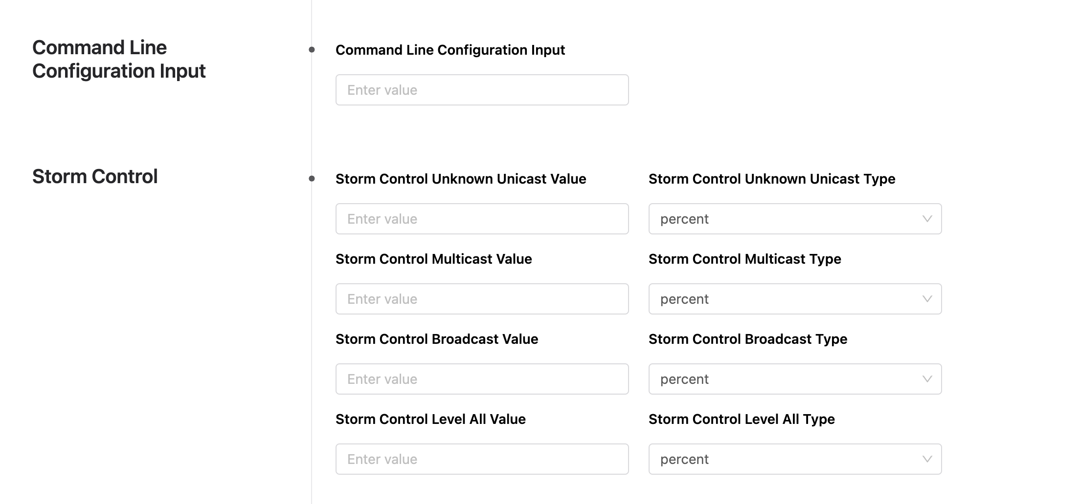
New command line and storm control options

Slide 15
Stacking in the Mgt Plane solves these issues
Merging the control plane of the stack members is perceived as a simplification but in reality, significant complexity is added to the software running the stack itself. Since a stack is inherently fate-sharing, software issues often impact the entire stack;
• The proprietary nature of stacking software and interfaces results in not only limited interoperability between different vendors but also between different product families and models from the same vendor;
• The stacking ports used to interconnect members usually require a proprietary ring topology using dedicated interfaces, inhibiting the flexibility of deployment and apportionment of limited bandwidth
• Stack port bandwidth varies between implementations and there are often hidden performance limitations. Understanding stack bandwidth is critical to ensure the stack ring does not become a choke point.
• Maintainability with a traditional stacked architecture must be considered such as removing a stack member or a faulty stack member may cause the switch stack to divide or partition into two or more stacks, each partition is a mirror of the other;
• Members within a stack are distance and topology limited due to the proprietary stacking cables or the timing requirements of the centralized control plane.
No need for all Stack members to be on the same EOS version.

